Slide 1


English Language Year 5 : PKSR 1 : Penulisan 014
Section A
( 10 marks )
Study notes below and use the information to complete the text.
RM 28.90
‘Swan’ School Bag
10 % discount
Back to school
Sales
grey
colour
gifts
souvenirs
big
light
Advantage :
Three compartments
014 @ khaidarwisy’s collections
2

Slide 2
English Language Year 5 : PKSR 1 : Penulisan 014
Based on the notes given, complete the text below with the correct information.
My father bought me a school bag yesterday. It was a ‘Swan’ branded school bag and it ____________________________ ( 1 ). He bag is grey in colour. It is also ______________________( 2 The advantages of this bag is that it has _____________________________ (3) where I can keep more things. The bag can also be as given ____________________________ (4). If you buy it now, you will get a __________________________________ (5) because there is a ‘Back To School Sales’.
014 @ khaidarwisy’s collections
3

Slide 3
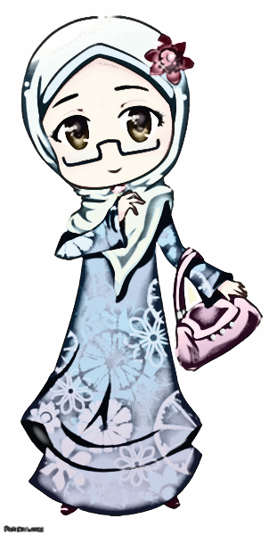

English Language Year 5 : PKSR 1 : Penulisan 014
Study the notice about a community centre and answer the following question in the spaces provided.
Kampung Permai
Community Centre Announcement
Children, are you looking forward to doing interesting activities this school holiday?
Then come on down to our Community Centre and sign up for our many classes.
To join the classes, you must:
be between 7 and 12 years old
be between 7 and 12 years old
be a resident of Kampung Permai
Have registered with Kampung Permai Community Centre
014 @ khaidarwisy’s collections
4

Slide 4
English Language Year 5 : PKSR 1: Penulisan 014
B ( i ) List three criteria for joining classes at Kampung Permai Community
Centre
( a ) _________________________________________________________________
( b ) _________________________________________________________________
( c ) _________________________________________________________________
( 3 marks )
014 @ khaidarwisy’s collections
5

Slide 5
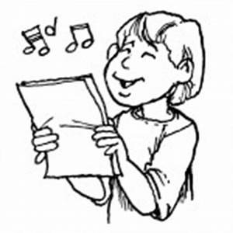
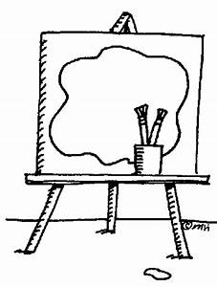



English Language Year 5 : PKSR 1 : Penulisan 014
Study the notice about a community centre and answer the following question in the spaces provided.
Kampung Permai
Community Centre Announcement
Activities during school holidays:
Activity | Day | Time
Singing Lesson By Encik Arif | Every Monday | 11.00 a.m. – 1.00 p.m.
Art Classes By Puan Normah | Every Tuesday | 10.00 a.m. - noon
Guitar Lesson By Mr. Simon | Every Wednesday | 2.00 p.m.- 4.00 p.m.
Baking Classes By Miss Nina | Every Thursday | 4.00 p.m. – 6.00 p.m.
014 @ khaidarwisy’s collections
6

Slide 6
B ( ii ) Your neighbour is interested in joining the classes at Kampung Permai
Community Centre. He/she would like to know more about the types of
classes that will be held.
Write an email to your neighbour telling him/her about at least three
classes he/she might be interested to join.
Write your answer between 50 to 80 words.
From : | Date :
To : | Time :
Subject :
( 12 marks )
014 @ khaidarwisy’s collections
7

Slide 7
Section C
( 25 marks )
This section consists of two questions. Answer one question only.
Question 1
Write a story based on the given pictures. You may use the words given to help you.
Write your story in the space provided.
Your story should be between 80 to 100 words.
-cycling– walking slowly – old lady – heavy
put – on the seat– pushed – bicycle - walk
thanked – kindness – mangosteens – happy – home

Slide 8
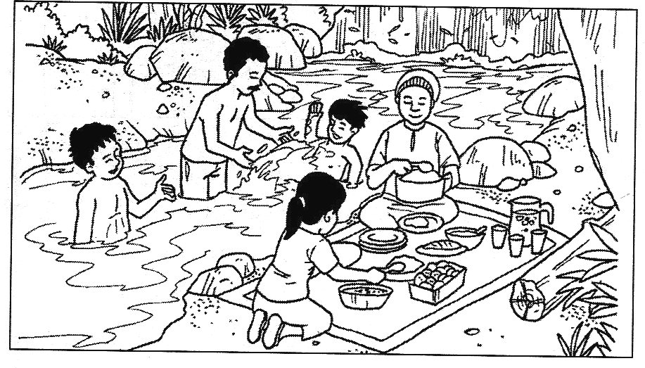
OR
Question 2
Write a story based on the picture below. You may use the questions given to help you. Write your answer in the space provided. Write your story between 80 to 100 words.
Describe the weather or surrounding.
What was the family doing?
Where were they?
What were the girl doing?
What was the woman doing?
What was the man doing?
What were the man doing?
What were the things laid on the maid?
How was the water?
Begin your story with :
Last school week, Encik Abu and his family went fora picnic at ........

Slide 9
________________________________________________________________________
________________________________________________________________________
________________________________________________________________________
________________________________________________________________________
________________________________________________________________________
________________________________________________________________________
________________________________________________________________________
________________________________________________________________________
________________________________________________________________________
________________________________________________________________________
________________________________________________________________________
________________________________________________________________________
________________________________________________________________________
________________________________________________________________________
________________________________________________________________________
________________________________________________________________________
________________________________________________________________________
________________________________________________________________________
________________________________________________________________________
________________________________________________________________________
________________________________________________________________________

Slide 10
________________________________________________________________________
________________________________________________________________________
________________________________________________________________________
________________________________________________________________________
________________________________________________________________________
________________________________________________________________________
________________________________________________________________________
________________________________________________________________________
________________________________________________________________________
________________________________________________________________________
________________________________________________________________________
________________________________________________________________________
________________________________________________________________________
________________________________________________________________________
________________________________________________________________________
________________________________________________________________________
________________________________________________________________________
KERTAS PEPERIKSAAN TAMAT

