Slide 1
Section A
( 20 marks )
Questions 1 to 5
Choose the best answer to complete the sentences.
Umarani has good study habits. She __________________ revises her lessons at the last minutes.
often
never
always
sometimes
2. Pathmaruban opened ________________ account at the bank.
a
an
the
-
Chitra and I are playing table tennis. ___________ are playing in the
school hall.
It
He
She
We
4. Vijay _________ to the radio when the postman arrived.
listens
listening
were listened
was listening

Slide 2
Sharmila walks away, _____________ the boys make fun of her.
although
since
but
so
Questions 6
Choose the most suitable idiom to complete the sentence below.
The two siblings are like ______________. They always fight over little things.
cats and dogs
let the cat out of the bag
cat and cheese
birds and eagles.

Slide 3
Questions 7-9
Choose the best answer to fill in the blanks in the passage that follow.
Last weekend, Suji and her family went ____________ ( 7 ) a safari park. They rode a tram that took them around the area. After that, they watched a magic show. Suji also had the chance to take a photo with ___________( 8 )
elephant. They went home in the late afternoon. Although tired, Suji ___________ ( 9 ) an enjoyable time.
7. A to
B for
C from
D towards
8. A a
B an
C the
D -
9. A has
B had
C have
D having

Slide 4
Questions 10
Choose the best word that has the same meaning as the underlined word.
I liked the shirt but I didn’t buy it because it was a bit expensive.
A pricey
B unique
C exclusive
D affordable
Questions 11
Choose the sentence with the correct punctuation.
11. A Oh no, I have spent all my allowance for the month.
B Oh no! I have spent all my allowance for the month.
C ‘Oh no, I have spent all my allowance for the month.’
D ‘Oh no, I have spent all my allowance for the month!’

Slide 5
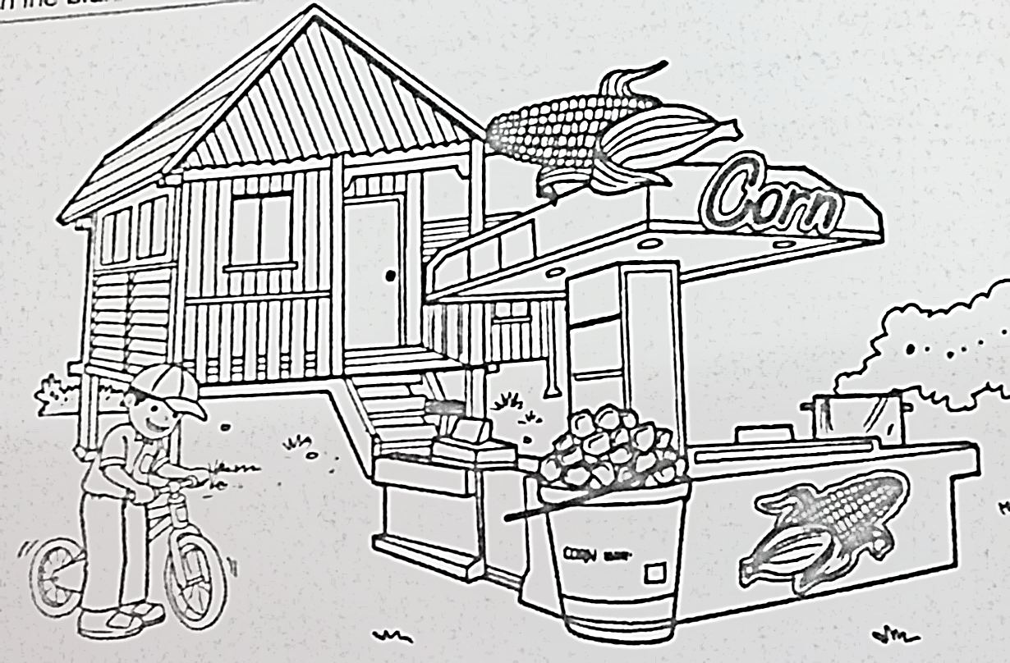
Questions 12-15
Read the passage and study the picture carefully. Then, choose the best answer to fill in the blanks.
Encik Iman is a hawker. He sells sweet corns near __________ (12) house. The residents there like to _____________ ( 13 ) the corns because they are _________________( 14 ). A boy named Alif wants to buy the corns. He wears a cap and ____________ ( 15 ) his bike towards the stall. Encik Iman’s sweet corns are normally sold out very fast.

Slide 6
12. A his
B her
C their
D my
13. A buy
B buys
C bought
D buying
14. A hard and smelly
B bitter and brown
C hard and tasteless
D cheap and tasty
15. A push
B pushes
C pushed
D pushing

Slide 7
Questions 16 to 18
Read the letter below and answer the questions that follow.
102, Jalan Woodland 2
Taman Woodland
27000 Jerantut
Pahang
9 March 2018
Dear Yanna,
How are you? I hope you are fine. Thanks for your letter which I received last week. I loved reading about your twin sisters. They are very funny! You have a lovely family. Please send my regards to them.
Now, I want to tell you about my family. I come from a large family. There are five family members altogether. My father is a doctor. He owns a clinic not far from our house. My father drives to the clinic every morning.
I am the youngest in the family. I also have two elder brothers. My eldest brother, Thinesh is studying Mechanical Engineering at the University of Malacca. My second brother, Selva is now in Form Three. He loves music.
During the next holidays, my family will be going to Malacca to visit Thinesh. I am looking forward to it. I hope to hear from you soon.
Yours sincerely,
Geetha
16. Who do you think Yanna and Geetha are?
Cousins
Pen-pals
Classmates
Neighbours

Slide 8
17. The word them in Paragraph 1 refers to _______________.
Yanna’s family
Yanna’s sisters
Geetha’s family
Geetha’s brothers
18. Geetha’s father goes to work ______________________.
by car
by bus
on foot
by bicycle
19. Why are Geetha and her family going to Malacca?
To visit the place of interest.
To visit Yanna and her family.
To visit Geetha’s brother.
To have a holiday.
20. From the letter, we know that ___________________.
Yanna has twin sisters
Yanna lives in Johor Bahru
Geetha is the eldest in the family
Geetha’s eldest brother is an engineer

Slide 9
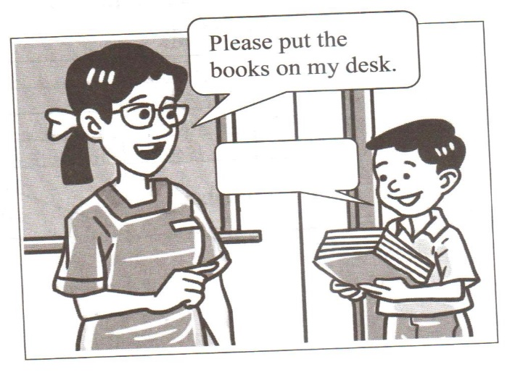
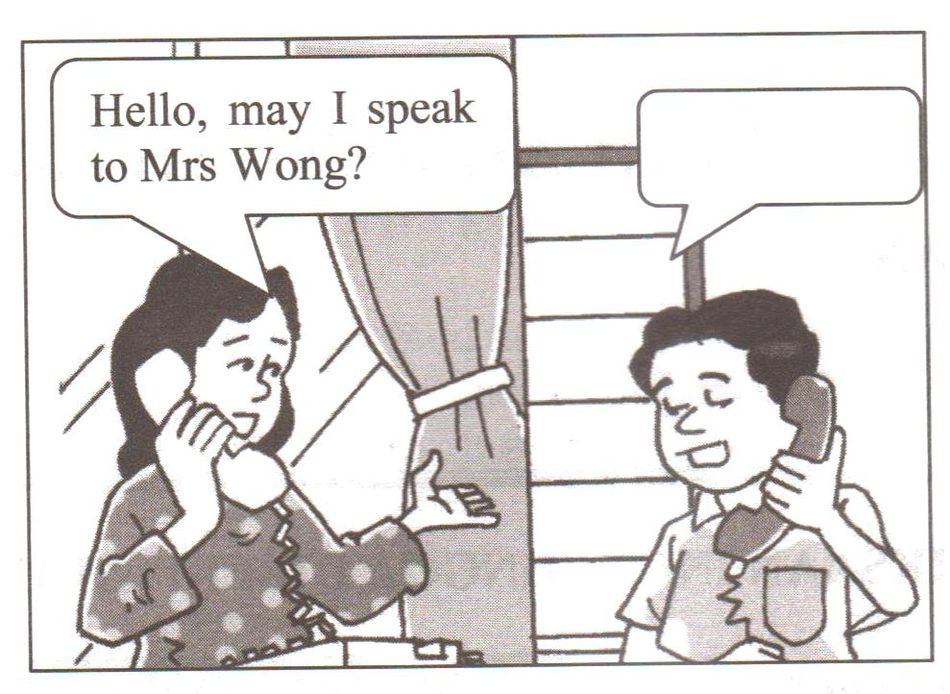
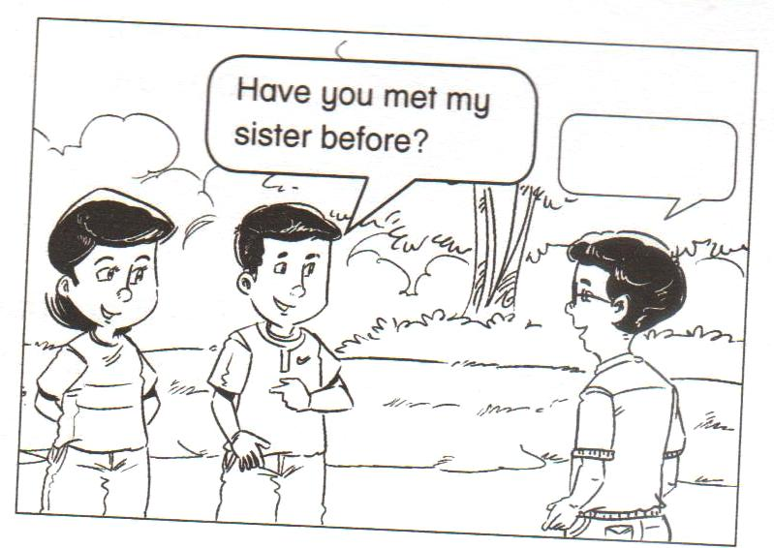
Section B
( 30 marks )
Questions 21
Choose a suitable response for each picture and write the response in the space provided.
(a)
Answer :
_______________________________________________________________________________________
( 2 marks )
(b)
Answer :
_______________________________________________________________________________________
( 2 marks )
(c)
Answer :
_______________________________________________________________________________________
( 2 marks )

Slide 10

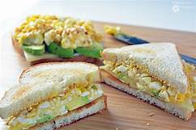
Questions 22
Ainah and Amira are preparing breakfast for their mother on Mother’s Day. This is the recipe that they are using to make their breakfast. Read the recipe below and answer the questions that follow.
EGG SANDWICH
Recipe
For ingredients:
20 slices of bread
5 hard boiled eggs
50 g of butter
1 cucumber
Salt and pepper to taste
Instructions / method :
Mash the eggs in a mixing bowl.
Add a pinch of salt and pepper.
Spread some butter on the bread.
Spread the egg mixture evenly on the bread.
Slice the cucumber thinly and arrange the sliced cucumbers on the bread.
Cut the sandwiches into triangles.
Pack the sandwiches.
Write True or False in the space provided.
Ainah and Amira are preparing some butter cookies for
their mother.
The ingredients for making the egg sandwiches are bread,
hard boiled eggs, butter, cucumber, salt and pepper.
( 2 marks )

Slide 11
Write your answer in the space provided.
List two seasoning that Ainah and Amirah useed to make the egg sandwich.
(i) _________________________________________________________ ( 1 mark )
(ii) _________________________________________________________ ( 1 mark )
What does Amira need to do after she spread the egg mixture evenly on the bread?
Which step in the recipe tells you this.
Answer : ____________________________________________________
____________________________________________________ ( 1 mark )
Step : ____________________________________________________( 1 mark )
Rearrange the instructions of making the egg sandwich.
Slice the cucumber thinly and arrange the slice cucumbers on the bread.
Spread some butter egg mixture evenly on the bread.
on the bread.
Mash the eggs in a mixing bowl and add a pinch of salt and pepper.
Cut the sandwiches into triangles and pack the
sandwiches.
( 2 marks )

Slide 12
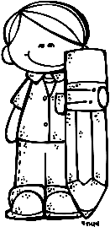
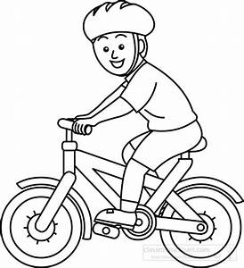
Questions 23
Study the diary below and answer the questions that follow.
Harith’s Diary ENTRIES
------------------------------------------
Friday, 11 Oktober
Today is my lucky day.
My uncle gave me RM 50.
He said I had done well in my final
examination so he wanted to give
me a reward. Saving it to buy a new
bicycle.
Saturday, 19 October
Grandpa dropped by for a visit.
He donated RM 50 to my bicycle fund.
Saturday, 12 October
Father gave me RM 10 for washing his car. Mother gave me RM 5 for cleaning the toilet. Have to do more chores to save more.
Sunday, 20 October
I am over the moon! I have got a new bicycle. Father topped up my savings. Said I deserve it. Hard work does pay off!
Wednesday, 16 October
Have been busy running errands for neighbours and helping out at home.
Have saved RM 100 so far.

Slide 13
Circle the correct answer to fill in the blank.
Example :
The potato chips cost _________.
RM 9.00 | RM 6.78 | RM 8.40
On ________________, Harith received RM 50 from his uncle.
( 1 mark )
.
11 October | 12 October | 20 October
How long did it take Harith to save RM 100?
( 1 mark )
Five days | Six days | Seven days
Match the phrases in List A to the suitable phrases in List B. An example is
given below.
(2 marks )
List A
Harith’s uncle gave him RM 50
Harith’s parents gave him RM 15
Harith’s grandfather donated RM 50
Harith got his new bicycle
List B
for helping out at home.
to his bicycle fund
as a reward for doing well in the examination.
on 20 October

Slide 14
Write your answer in the space provided.
Give two reasons why Harith was very happy on 20th October.
(i) __________________________________________________________________
(ii) _________________________________________________________________
( 2 marks )
‘running errands for neighbours’
(e) What do you understand by the phrase above?
____________________________________________________________________
____________________________________________________________________
( 2 marks )

Slide 15


Questions 24 and 25
Study the poster and read the dialogue given. Then, answer the questions that follow.
THE VILLAGE
SWIMMING POOL
OFFICIAL OPENING
Sunday, 11 March 2018
10.30 a.m. to 4.30 p.m.
A fun day for the whole family!
Special event :
Official opening by a special guest
Lucky Draw
Activities:
Swimming session ( 1.30 p.m. to 4.30 p.m. )
Aqua aerobic session
Diving demonstration
Water polo session
Synchronised swimming demonstration
Throughout the day:
Food, drinks, ice creams, games and prizes

Slide 16
Sweet Peng : | Soon, we’ll get to swim in The Village.
Gwen : | What’s that?
Sweet Peng : | That’s the name of the new swimming pool in our neighbourhood. It will be officially open on Sunday.
Gwen : | Oh, I’d love to go! I wonder if there’ll be any activities
Sweet Peng : | I saw the poster announcing the official opening. There’ll be many activities and demonstrations.
Gwen : | Great!
Sweet Peng : | After 11 March, I’ll be able to indulge in one of my favourite past times as often as I like.
Questions 24
Tick (√) the correct answer..
If Sweet Peng goes to The Village swimming pool opening at 2.30 p.m., she can…..
( 1 mark )
go swimming
watch the divers
participate in aqua aerobics
‘It will be officially opened on Sunday.’ The word It in the dialogue refers
to ……..
( 1 mark )
the swimming pool
the neighbourhood
the lucky draw

Slide 17
Questions 25
Write your answer in the space provided.
( a )
Throughout the day : Food, drinks, ice creams, games and prizes
Why do you think this information is in the poster?
____________________________________________________________________
____________________________________________________________________
( 2 marks )
( b ) Why do you think Sweet Peng says she will be able ‘to indulge in one of
my favourite pastimes as often as I like’ ?
____________________________________________________________________
____________________________________________________________________
____________________________________________________________________
( 2 marks )
( c ) Why is the event described as ‘A fun day for the family’ ?
____________________________________________________________________
____________________________________________________________________
____________________________________________________________________
( 2 marks )
BAHAGIAN B TAMAT

